Slide 1
DECODING IMDB REVIEWS
UNCOVERING INSIGHTS THROUGH DATA ANALYTICS

Slide 2
CONTENT
PROJECT DESCRIPTION
APPROACH
TECH-STACK USED
INSIGHTS
RESULT

Slide 3
PROJECT DESCRIPTION
IMDb IS A WELL-KNOWN WEBSITE THAT ENABLES USERS AND REVIEWERS TO RATE FILMS AND TELEVISION SHOWS. WE MAY DISCOVER REVIEWS OF FILMS AND TELEVISION SHOWS ON IMDb, ALONG WITH BIOS OF THE CAST MEMBERS AND DIRECTORS. HERE, THE IMDb DATASET FOR MOTION PICTURES FROM 1927 TO 2016 IS MADE AVAILABLE. THIS INCLUDES DETAILS ON THE PERFORMERS, DIRECTORS, BUDGET, AND OTHER ASPECTS OF THE FILM. WE'RE GOING TO USE OFFICE 365 EXCEL'S APPROACH TO CLEAN THE DATASET AND OBTAIN THE REQUESTED INFORMATION.

Slide 4
APPROACH
IN ORDER TO COMPLETE THIS ASSIGNMENT, WE MUST FIRST COMPREHEND THE PROVIDED DATA.
THEN, WE WILL CLEAN THE DATA TO MEET OUR NEEDS BY ELIMINATING NULL VALUES, EXTRANEOUS COLUMNS, ETC.
FOLLOWING THE CLEANING, WE WILL USE PIVOT TABLES, SEVERAL FUNCTIONS, AND CHARTS TO OBTAIN THE NECESSARY ANSWERS TO THE QUERIES.
WE'LL KEEP ASKING WHY QUESTIONS OF THE DATA TO GO FURTHER INTO THE ISSUE'S CAUSE.
AT THE CONCLUSION, WE'LL STRUCTURE OUR RESPONSES PROPERLY IN A TABLE AND SOME GRAPHS.

Slide 5
TECH-STACK USED
MICROSOFT EXCEL ( 2021 )
GOOGLE SHEETS

Slide 6
INSIGHTS
TASK 1 : CLEAN THE DATA
DROP UNNECESSARY COLUMNS( COLOR, DIRECTOR_FACEBOOK_LIKES, ACTOR_1_FACEBOOK_LIKES, ACTOR_2_FACEBOOK_LIKES, ACTOR_3_FACEBOOK_LIKES, ACTOR_2_NAME, CAST_TOTAL_FACEBOOK_LIKES, ACTOR_3_NAME, DURATION, FACENUMBER_IN_POSTER, CONTENT_RATING, MOVIE_IMDB_LINK, ASPECT_RATIO, PLOT_KEYWORDS )
REMOVE NULL VALUE.
REMOVE DUPLICATES.
LINK : https://bit.ly/task_5_1

Slide 7
TASK 2 :FIND THE MOVIES WITH THE HIGHEST PROFIT
TO CALCULATE THE PROFIT, WE MUST FIRST SUBTRACT THE BUDGETED AMOUNT FROM THE GROSS SUM.
NEXT, WE'LL PLOT VALUES BY UTILISING THE SCATTER PLOT OPTION.
THEN, WE WILL VISUALISE THE VALUES OF PROFIT (Y_AXIS) AND BUDGET (X_AXIS) USING THE SCATTER PLOT OPTION.
THEN, USING THE GRAPH, WE WILL IDENTIFY ANY OUTLIERS. THEN, USING THE GRAPH, WE WILL IDENTIFY ANY OUTLIERS.

Slide 8
TOP 5 HIGHEST PROFITED MOVIES
Movie Tilte | Profit
Avatar | 523505847
Jurassic World | 502177271
Titanic | 458672302
Star Wars: Episode IV - A New Hope | 449935665
E.T. the Extra-Terrestrial | 424449459
LINK : https://bit.ly/task_5_2

Slide 9
TASK 3:- FIND IMDB TOP 250
USE THE FILTER TO EXCLUDE ANY DATA WHEN NUM_VOTED_USERS EXCEEDS 25,000.
THE IMBD_SCORE COLUMN IS USED TO DESCENDINGLY RANK THE DATA. WE WILL ONLY BE ANALYSING THE TOP 250 ENTRIES.
WE'LL USE THE FORMULA “=RANK(M2,$M$2:$M$251,0) +COUNTIFS($M$2:M2,M2)-1 ” TO GET RANK.
REMOVE THE LANGUAGE FILTER BY DESELECTING ENGLISH. IT RESULTS IN FOREIGN FILMS BEING ON OUR TOP 250 LIST.

Slide 10
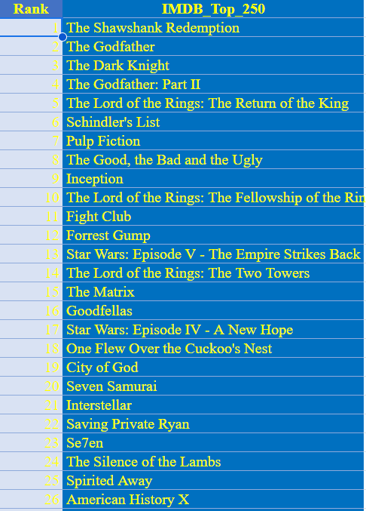
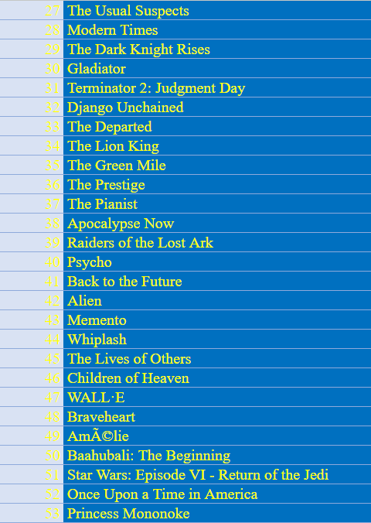
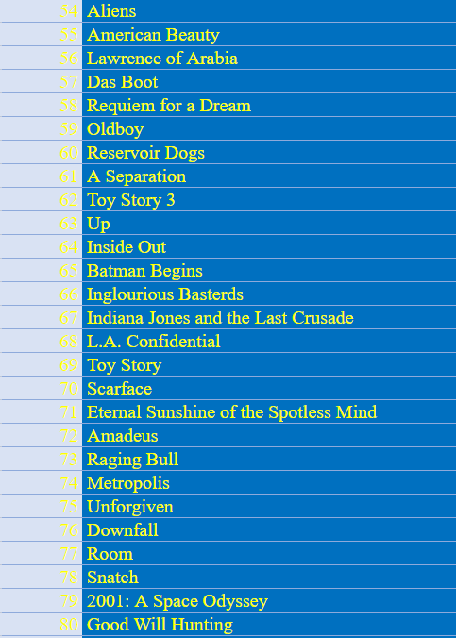
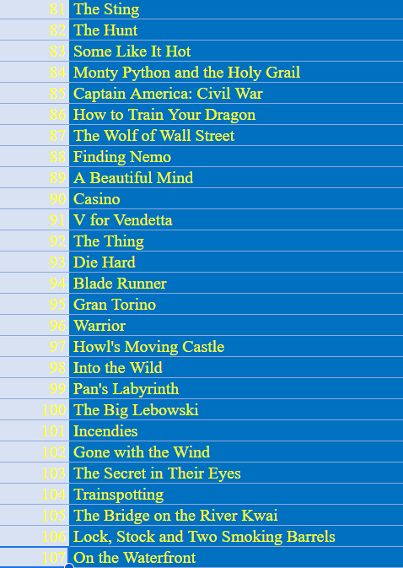

Slide 11
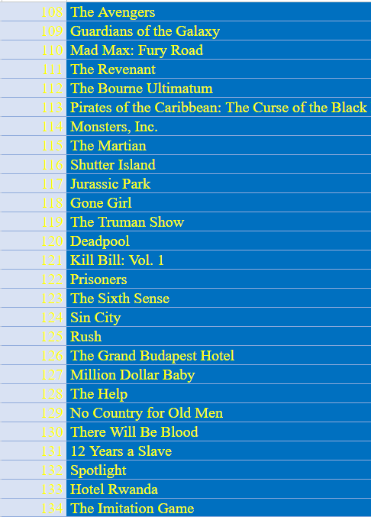
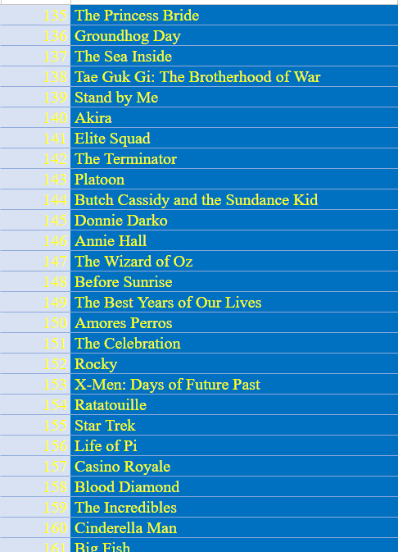
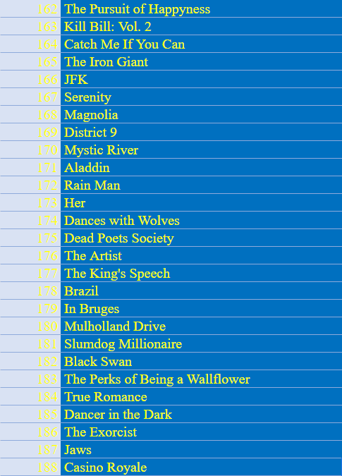
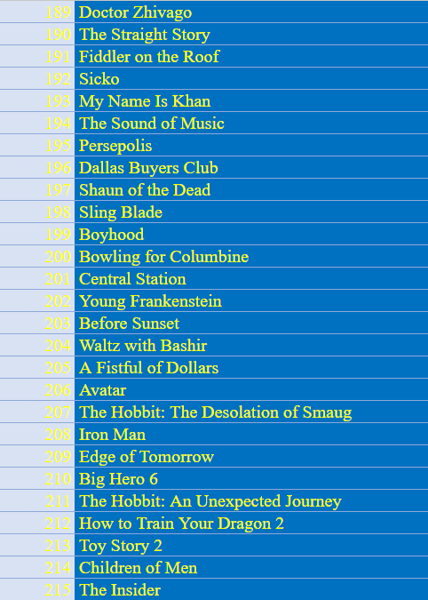

Slide 12
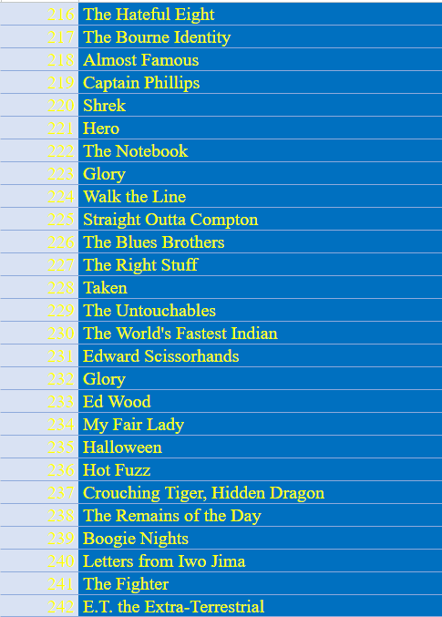
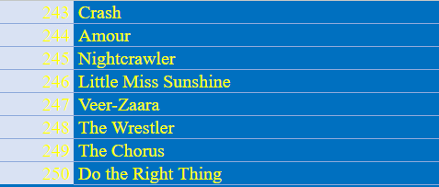
LINK : https://bit.ly/task_5_3_top250
LINK : https://bit.ly/task_5_3_Top_Foreign_Lang_Film

Slide 13
TASK 4: FIND THE BEST DIRECTORS
FIRST, CHOOSE THE IMDB_SCORE COLUMN FROM THE CLEANED DATASET.
THE PIVOT TABLE WILL THEN BE SELECTED.
DIRECTOR_NAME WILL BE ADDED TO THE PIVOT TABLE'S SERIES SECTION.
THE PIVOT TABLE'S VALUES SECTION WILL THEN RECEIVE THE ADDITION OF THE AVERAGE IMDB_SCORE.
THE DATA WILL THEN BE SORTED BASED ON THE AVERAGE IMDB_SCORE AFTER THAT IMDB_SCORE IS FIRST IN DESCENDING ORDER, THEN ALPHABETICALLY BY DIRECTOR NAME.

Slide 14
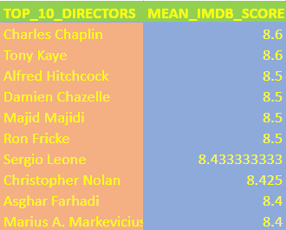
LINK : https://bit.ly/tasl_5_4_Top_10_Directors

Slide 15
TASK 5: FIND POPULAR GENRES
CHOOSE THE GENRE COLUMN IN THE CLEANED DATASET FIRST.
NEXT, WE'LL CHOOSE THE PIVOT TABLE OPTION.
NEXT, WE'LL CHOOSE THE GENRE NAMES FOR THE ROW LABELS.
THE VALUES ARE THEN CONVERTED TO A COUNT OF THE GENRES, AND THE GENRE COUNTS ARE USED TO SORT THE DATA IN DECREASING ORDER.

Slide 16
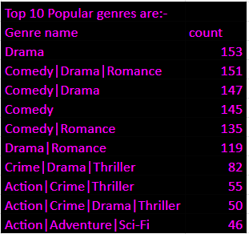
LINK : https://bit.ly/3reXFHH

Slide 17
TASK 6 : FIND THE CRITIC-FAVORITE AND AUDIENCE-FAVORITE ACTORS
ADDED THREE ADDITIONAL DATA FRAMES WITH THE NAMES MERYL STREEP, LEONARDO DICAPRIO, AND BRAD PITT.
THESE FRAMES FEATURED THE FILMS IN WHICH THE AFOREMENTIONED ACTORS PLAYED THE PRINCIPAL ROLES.
THE ROWS OF EACH OF THESE DATA FRAMES WERE THEN ADDED TO AND SAVED IN A NEW DATA FRAME CALLED "COMBINED."
NEXT, USE THE ACTOR_1_NAME COLUMN TO GROUP THE 'COMBINED’ , CALCULATED THE MEAN OF NUM_CRITIC_FOR_REVIEWS AND NUM_USERS_FOR_REVIEW.

Slide 18
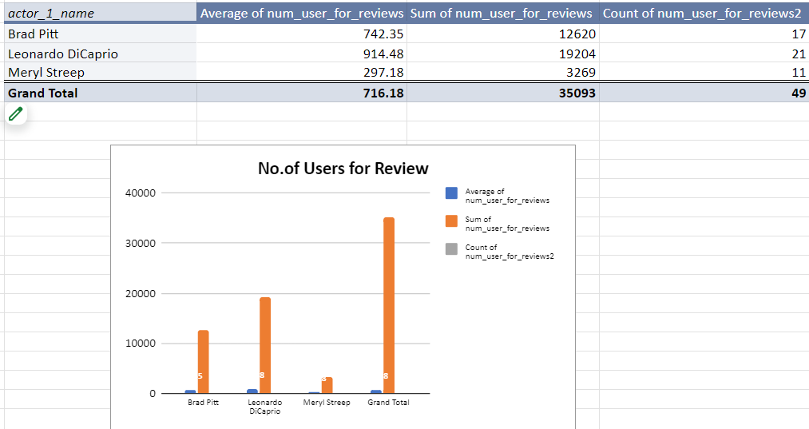

Slide 19
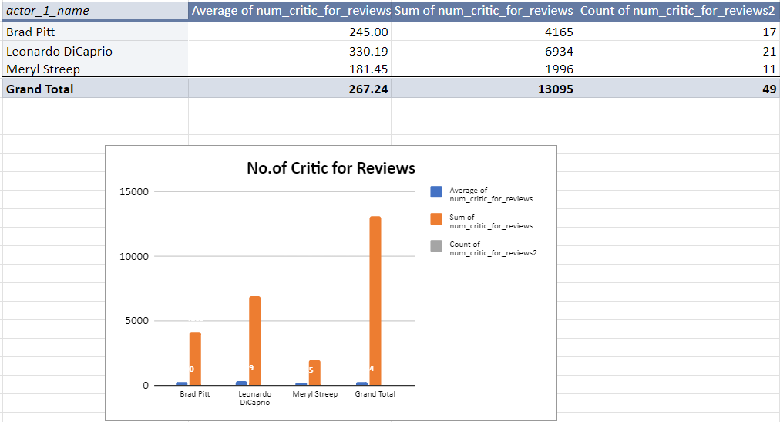
LINK : https://bit.ly/3rpcreZ

Slide 20
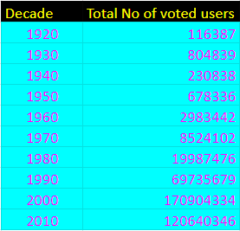
LINK : https://bit.ly/3pNxxmV

Slide 21
RESULT
IN ORDER TO EXTRACT THE REQUIRED FINDINGS FROM THE DATASET FOR THIS IMDb MOVIE ANALYSIS PROJECT, I HAVE DEVELOPED A RANGE OF LOGICAL, STATISTICAL, AND TECHNOLOGICAL ABILITIES. I CAN BETTER UNDERSTAND THE DATA AND EVALUATE IT WITH THE USE OF STATISTICS CONCEPTS LIKE AVERAGE, FREQUENCY TABLES, AND IDENTIFYING OUTLIERS. MY ABILITY TO USE STATISTICS AND MICROSOFT EXCEL'S TECHNICAL SKILLS TO ASSESS DATA PROCESSES USING DATA ANALYTICS ARE CONSIDERABLY EXPEDITED. SIMPLIFIES COMPLICATED CALCULATIONS THAT TAKE A LONG TIME. THROUGH ITS DATA VISUALISATION FEATURES, I ALSO GET A SENSE OF HOW EASILY UNDERSTANDABLE DATA IS WHEN IT IS PRESENTED VISUALLY. BASED ON THE FACTS AND THE DESIRED RESULTS, I LEARN WHEN TO UTILISE EACH GRAPH OR CHART.

